Slide 1
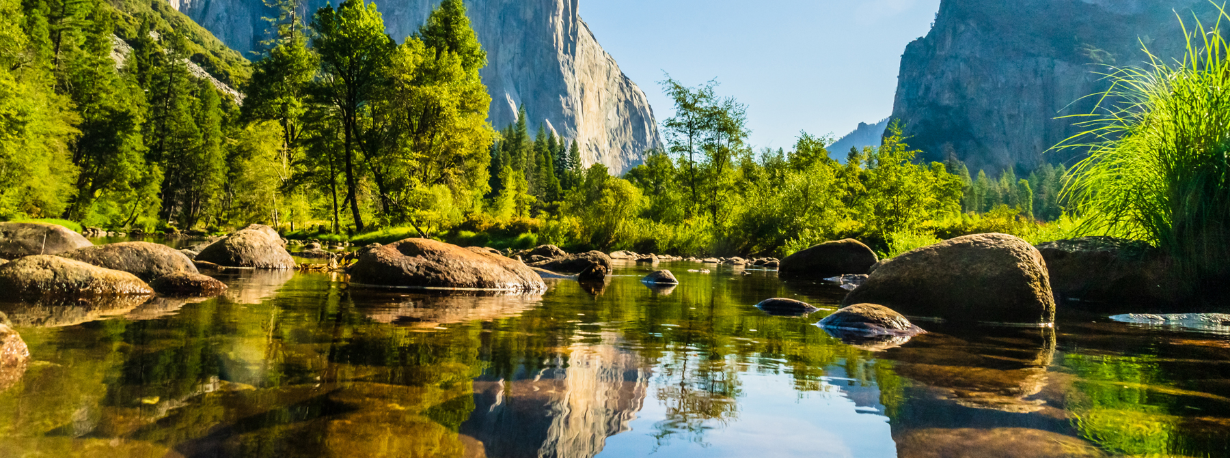
National & State Parks
DSCI 511 Term Project
Ashwina Mistry, Rishav Sarangi, Tien Nguyen, Xi Chen
March 14, 2021

Slide 2
Table of Contents
Introduction
Project Description
Usage
Development
Challenges and Limitations
Workload Distribution

Slide 3
Introduction
Application
Users
This project collects the data of 468 US National Parks and state parks from all 50 states
Data is stored in .csv files and can be used for further development by anyone to locate the map and find its information
The data we collect should be helpful for anyone looking to visit the national parks and spend time in the vicinity of nature for recreation
It will help decide whether that is the place they are looking for to visit depending on their interests

Slide 4
Project Description
National Parks
The data source for national parks will be from the National Park service website which contains information about the 468 parks in the country
The columns will include park name, latitude, longitude, description, activities and weather
State Parks
The state parks will be extracted from Wikipedia
The data set will contain similar information including the title, park code, latitude, longitude, and description of each park

Slide 5
Usage
Download Files
Download NationalParks.ipynb and StateParks.ipynb
Install Libraries
Install all required libraries
Run
Once installed, simply run the modules
Access and View
Access and view the datasets (.csv files)
If using Jupyter Notebook, only Wikipedia needs to be installed

Slide 6
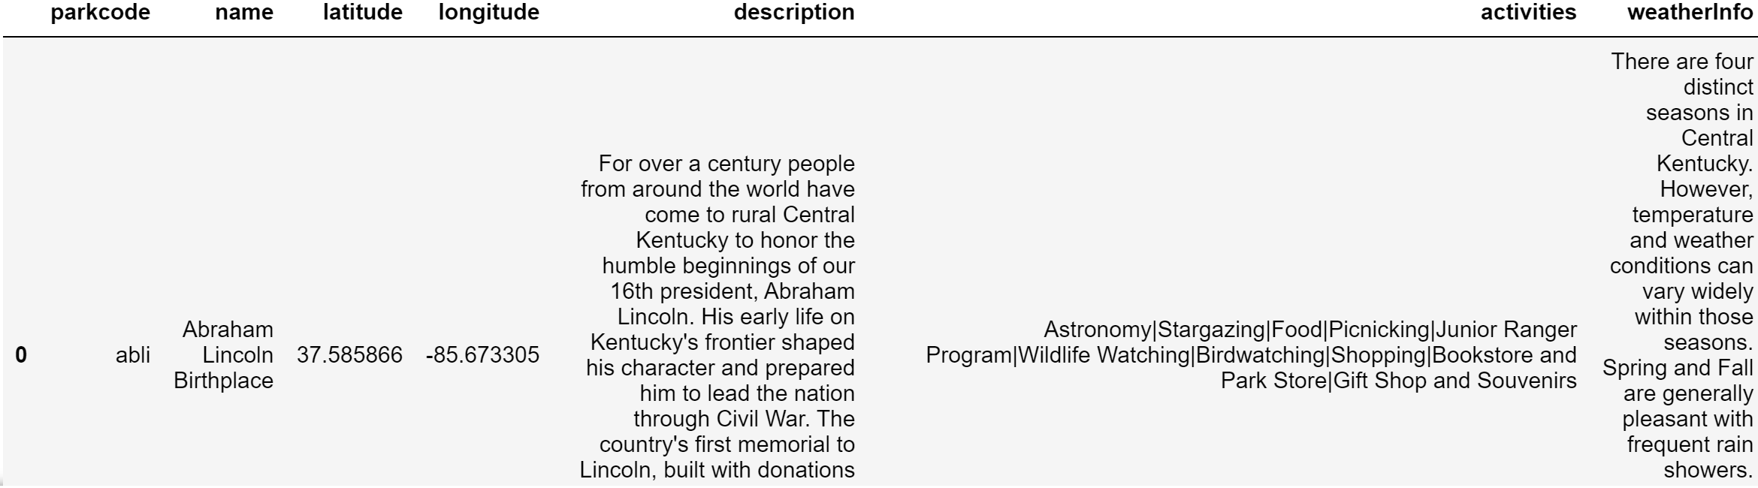
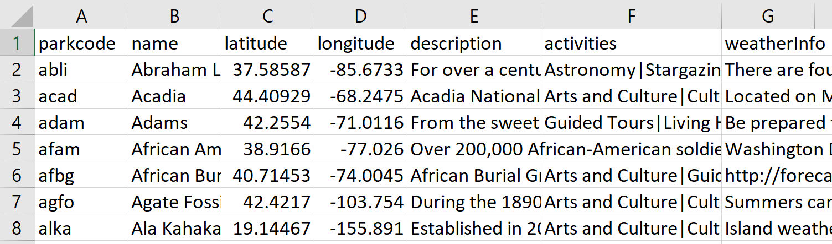
Sample Dataset National Parks

Slide 7
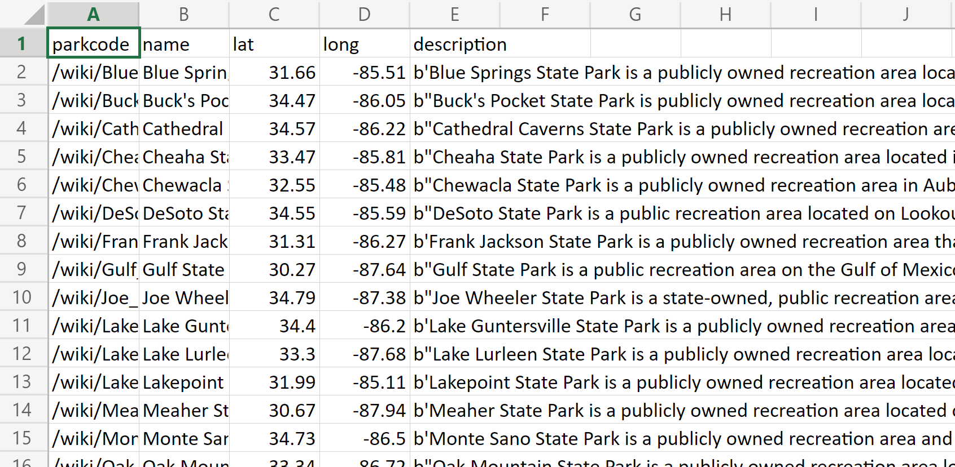
Sample Dataset State Parks

Slide 8
Development NationalParks.ipynb
The code navigates to https://www.nps.gov and collects park name codes by web scraping using BeautifulSoup
Function park(code) creates API requests using the park code
The following information is collected:
Park name, latitude, longitude, description, weather, and activities
Nationalpark.csv file stores the values of dictionary
The function can be carried out up to 468 times to collect information for all national parks
The information will also be displayed in a table using pandas.

Slide 9
Development StateParks.ipynb
Creates a list of 50 states by web scraping from Wikipedia
Once the state names are collected, URL is created for each state park by filling the URL format with the state names
For example, for the state of Alabama, the URL is: https://en.wikipedia.org/wiki/List_of_Alabama_state_parks
URL is created for each park of the stateData is scraped from each individual park website for information
Data will be collected for each park in the state
Repeated for up to 50 times to collect information on state parks from all 50 states

Slide 10
Challenges and Limitations 1. Limit for Requests
One of the challenges was that the code was sending multiple requests in a short period of time and these requests are sometimes blocked
Resolved this by placing a time delay before each request is sent
Another challenge was request limit for nps.gov, which is 1000
While troubleshooting, the code sometimes reached the request limit
Hence, the website was blocking from sending request as max retry limit was exceeded

Slide 11
Challenges and Limitations 2. Inconsistent Information
Information about state parks on Wikipedia is inconsistent
The name of the categories are from state to state
Therefore, using the same script to extract information from all the park websites is impossible
For example, we were able to extract information about "activities" for state parks in Alabama, but that would not work for New York and other states
Each state requires a different script to extract the desired information
In addition, not all state park Wikipedia articles contain their coordinates
Also unable to find weather info on Wikipedia

Slide 12
Challenges and Limitations 3. Reliability of Data Source
Wikipedia is not a reliable source
Information on Wikipedia can be edited by anyone at anytime
This means the information in contains can be a work in progress, not up to date, or plain wrong
We decided to use Wikipedia to generate information of state parks because we were not able to find a collection of state park information on any other website

Slide 13
Workload Distribution
Ashwina Mistry
Developed modules NationalParks.ipynb and StateParks.ipynb
Rishav Sarangi
Wrote README
Tien Nguyen
Refined modules and debugged
Xi Chen
Refined module, helped with debugging, and created presentation

